Slide 1
Chapter 9 UDP
Process-to-process communication
User datagram
Checksum
UDP operation
Use of UDP
UDP package

Slide 2
Transport Layer
Functions: serve as the intermediary between the application programs and the network operations
  Create a process-to-process communication
  Provide a control mechanism at the transport layer
  Provide a connection mechanism for the processes
Protocols
  Transmission Control Protocol, TCP
  User Datagram Protocol, UDP

Slide 3
9.1 Process-to-Process Comm.
进程
Process
进程
Process
端点（endpoint）
协议端口（port）
IP地址
Internet
Domain of IP protocol
Domain of transport protocols

Slide 4
Port Numbers
客户
Client
服务器
Server
…
…
52000
多目标
并发通信
13
传输协议
传输协议
Data
13
52000
13
52000
Data

Slide 5
IP Address vs. Port Number
…
13
Transport
Layer
Port
number
 | 13
Choose
process
IP header
193.14.26.7
 | 13
193.14.26.7
IP
address
Choose
host
Transport
protocol
header

Slide 6
IANA Ranges
0
1023
49152
65535
1024
49151
Well-known
Registered
Dynamic
Well-known ports
  Assigned and controlled by IANA
Registered ports
  Not assigned or controlled by IANA
  Can only be registered with IANA to prevent duplication
Dynamic ports
  Neither controlled nor registered
  Can be used by any process
Notes:
The Internet Assigned Numbers Authority

Slide 7
Well-known Ports
http://www.iana.org/assignments/port-numbers
  The well-known Ports on most systems can only be used by system (or root) processes or by programs executed by privileged users
  To the extent possible, some port assignments are both used with the TCP and UDP
    Example：port 53（DNS）

Slide 8
Socket Addresses
Generic structure
struct sockaddr {
  short sa_family;
  chat sa_data[14];
};
Address families
  AF_LOCAL
  AF_INET
  ……
DARPA Internet style
struct sockaddr_in {
  short sin_family;
  unsigned short sin_port;
  unsigned long sin_addr;
  char sin_zero[8];
};

Slide 9
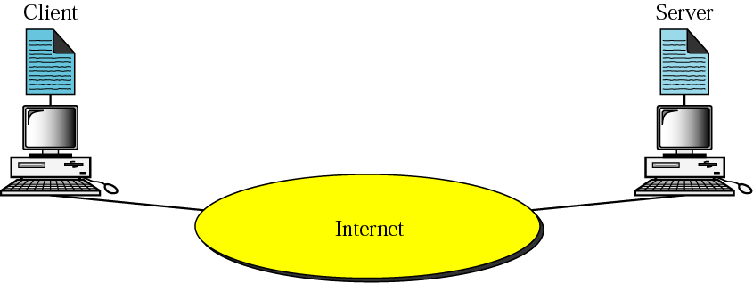
Client-Server Model

Slide 10
Client & Server
Client（客户）
  A program running on the local machine requesting service from a server
  Finite
  Active open and active close
Server（服务器）
  A program running on the remote machine providing service to the clients
  Infinite
  Passive open

Slide 11
Concurrency
Client
  Iteratively: running one by one
  Concurrently: running at the same time
Server
  Connectionless iterative server: use UDP
  Connection-oriented concurrent server: use TCP

Slide 12
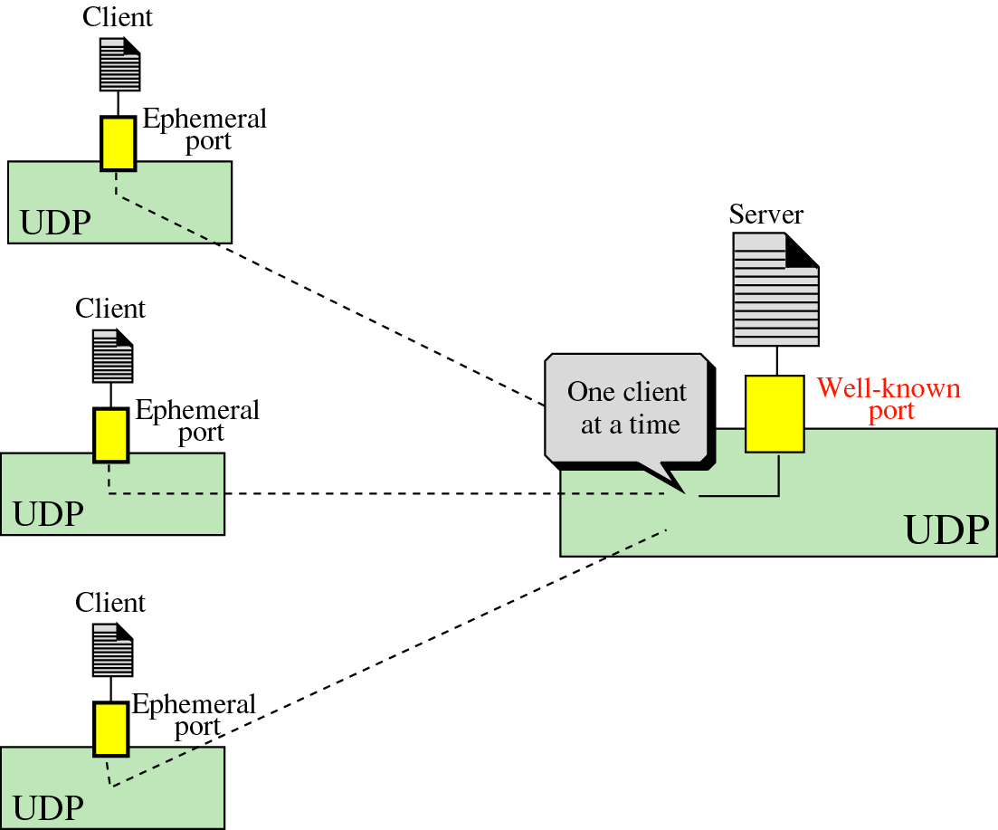
Connectionless Iterative Server

Slide 13
9.2 User Datagram
User Datagram Protocol，UDP
  RFC 768，用户数据报协议
Application Layer
Transport
Layer
TCP
UDP
Network
Layer
ICMP
IGMP
IP
ARP
RARP
Network
Access Layer
LANs
MANs
WANs

Slide 14
User Datagram Format
IP header
IP header
IP data
IP data
Protocol = 17
UDP Header
Data
Source port number
16 bits
Destination port number
16 bits
Total length
16 bits（0～65535）
Checksum
16 bits
The length of the data can be between 0 and 65507
IP header
65507 = 65535 – 20 – 8
UDP header

Slide 15
9.3 Checksum
UDP checksum
  与IP校验和的计算方法相同
  校验内容不同，包括三个部分：
  Pseudo header + UDP header + Data
Pseudo header（伪首部）
  根据IP首部的部分信息形成
  不会与UDP报文一起发送到网络上
  进一步确保UDP报文送到正确主机的正确端口上
Checksum → Optional
  减少高可靠性网络上的传输开销

Slide 16
Pseudo Header Format
Source IP address
Pseudo
header
Destination IP address
All 0s
Protocol
UDP total length
Header
Source port number
Dest. port number
UDP total length
Checksum
Data

Slide 17
9.4 UDP Operation
A connectionless, unreliable transport protocol
  To create a process-to-process communication
  Connectionless: 不同路径、不编号、面向报文
  No flow control
  A litter error control: checksum
对IP协议增强
  主机多目标通信的区分，允许多个通信并发进行而不会发生混淆

Slide 18
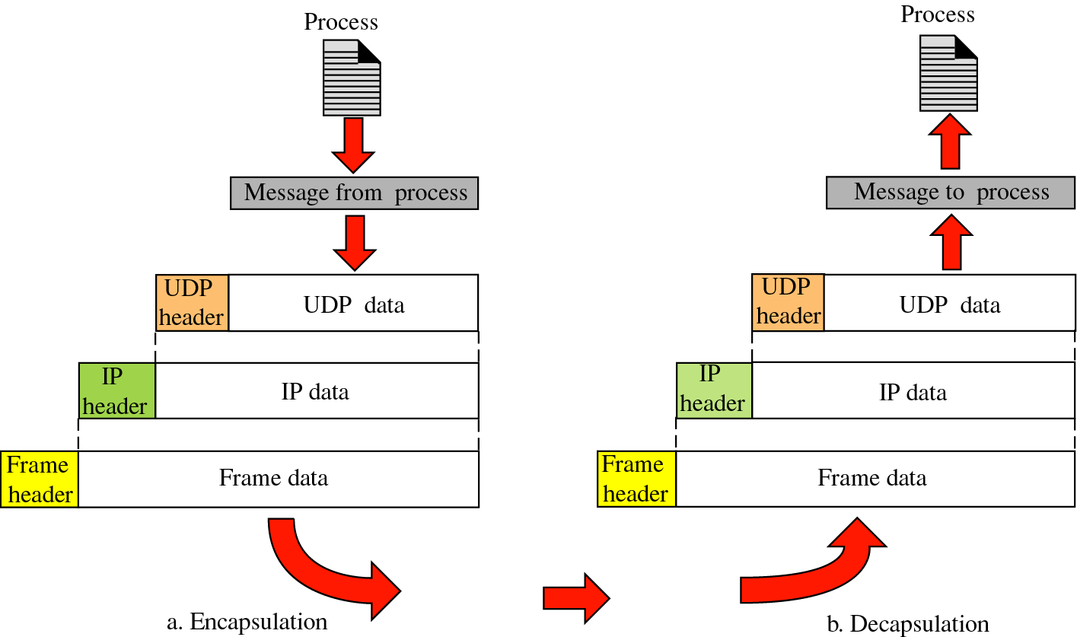
Encapsulation & Decapsulation

Slide 19
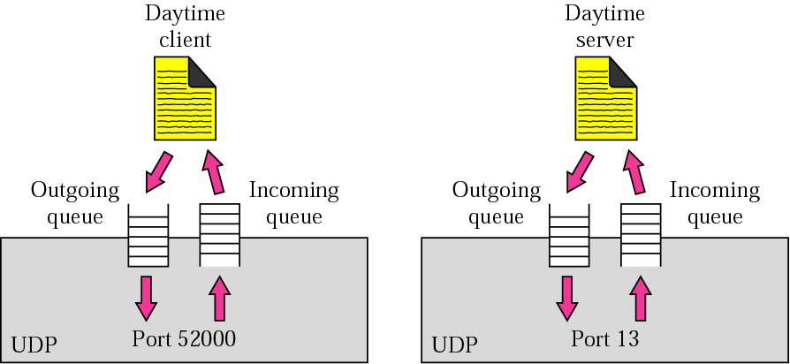
Queues in UDP
队列是与端口相关联在一起的
进程←→入队列/出队列 or 进程←→入队列

Slide 20
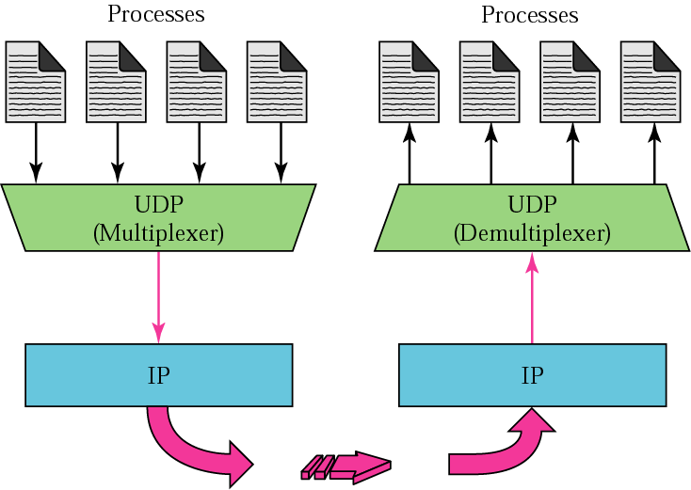
Multiplexing & Demultiplexing

Slide 21
9.5 Use of UDP
简单、简短的应用
  简单的请求-响应通信，如查询操作、网络管理
  IP phone，利用UDP快捷的特点
  具有内部流控和差错控制的进程，如TFTP
  组播或广播应用
  某些路由协议，如RIP
一般使用方式 —— 客户/服务器模式
  服务端：固定守候在特定port x，提供服务
  客户端：动态绑定任意port n，向服务器port x发出请求，获得服务响应

Slide 22
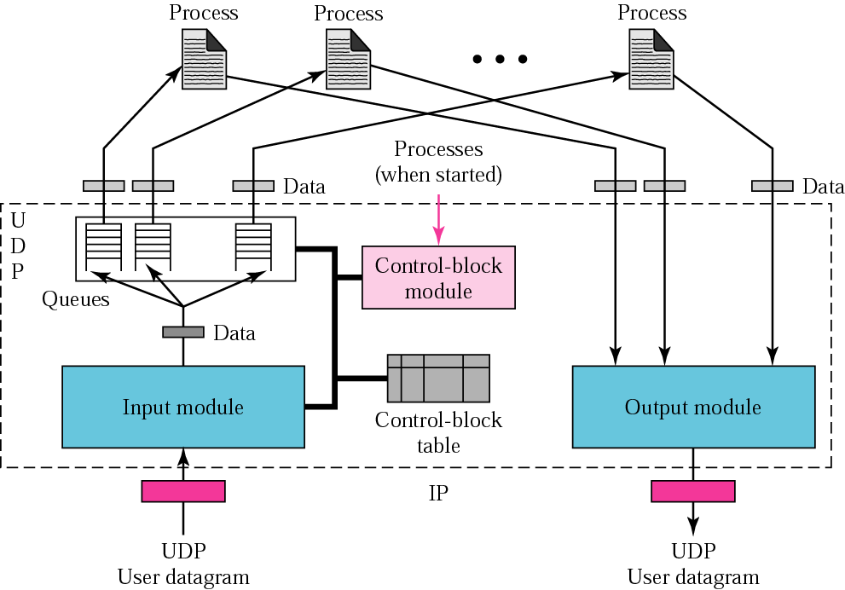
9.6 UDP Package

Slide 23
Discussion
应用的需要
伪首部使得IP层和UDP层的界线模糊不清
  考查UDP协议软件在发送报文时如何计算校验和
计算CS的困难：
计算前需要知道sIP，但在IP选路前，sIP是未知的（sIP与选择的NI有关）
计算步骤：
. 封装成UDP送给IP层
. IP层完成选路，得到sIP，再送回UDP层
. UDP层计算CS，再送IP层
UDP接收也有类似问题
（dIP，dPort，Data）
sPort
UDP
封装UDP
计算CS
17
IP
I₁
I₂
I₃
NI1
NI2
NI3

Slide 24
9.7 Summary
进程到进程的通信
  端点（IP地址，端口）
UDP
  通信特点：无连接、不可靠
  作用
UDP报文
  格式：伪首部、校验和的含义和作用
  封装：直接封装在IP分组中

